Slide 1
JIU IT Major 20230124 PMJ, AEJ
Object-Oriented Programming
Practice Week5

Slide 2
Do you know Bobgo?
Bobgo = 밥 (rice) + Go!

Slide 3
Do you know Bobgo?
Bobgo = 밥 (rice) + Go!
Once a week, community/friends would have a meal together.
ex) Monday Lunch babgo

Slide 4
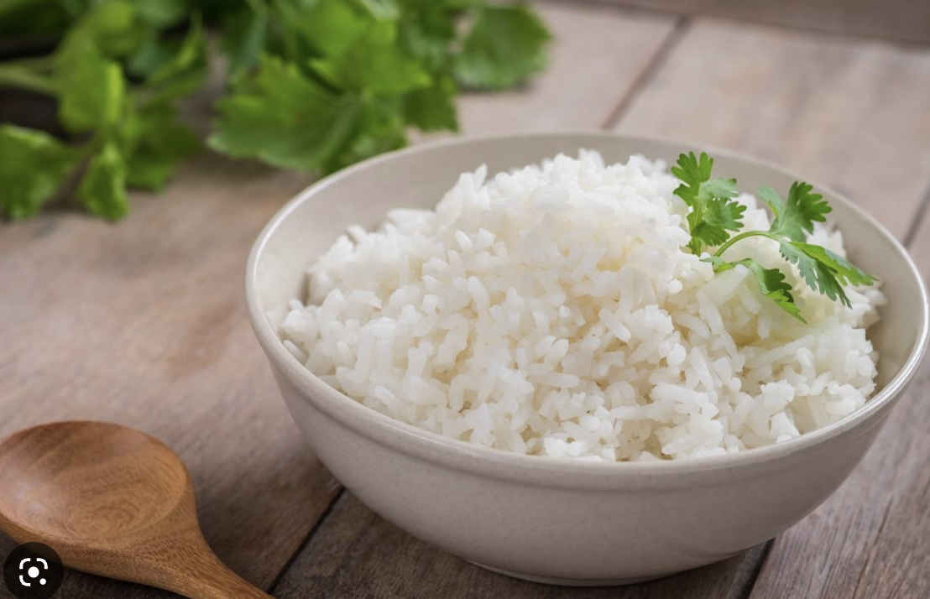
How about…
NASI + Go
in JIU?

Slide 5
Let’s make IT major
NASI + Go
On Tuesday Lunch? Or Wednesday?

Slide 6
1.2 Computer can execute the code in ____________.
machine language
B. assembly language
C. high-level language
D. none of the above

Slide 7
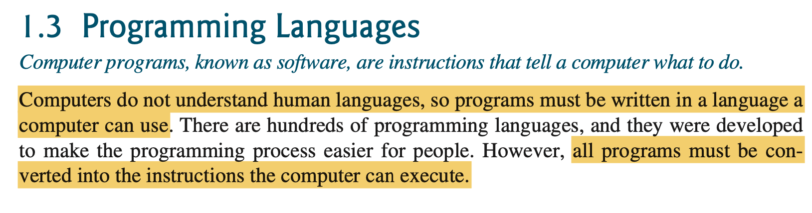
1.2 Computer can execute the code in ____________.
machine language
B. assembly language
C. high-level language
D. none of the above

Slide 8
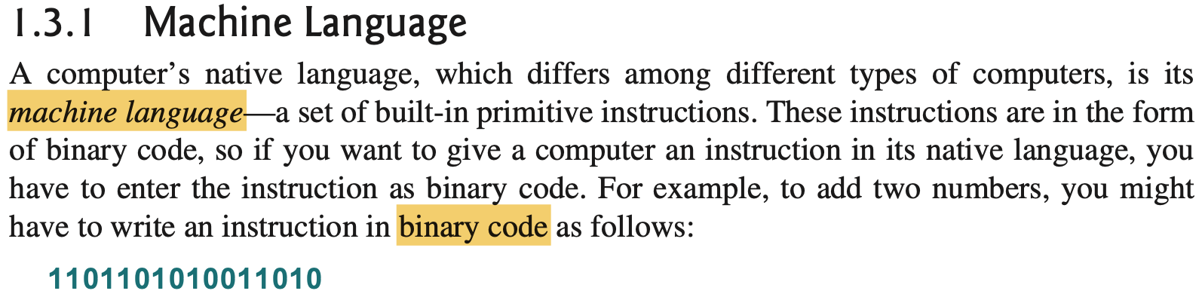
1.2 Computer can execute the code in ____________.
machine language
B. assembly language
C. high-level language
D. none of the above

Slide 9
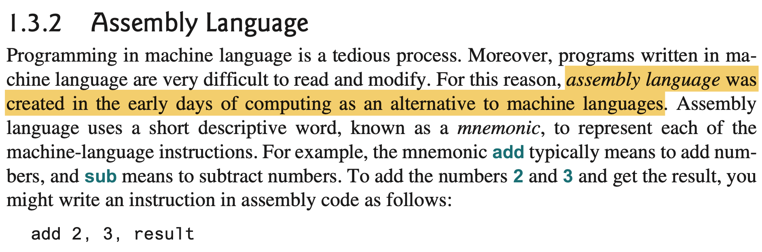
1.2 Computer can execute the code in ____________.
machine language
B. assembly language
C. high-level language
D. none of the above

Slide 10
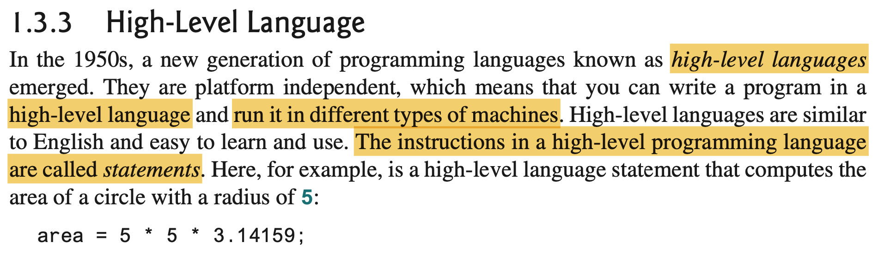
1.2 Computer can execute the code in ____________.
machine language
B. assembly language
C. high-level language
D. none of the above

Slide 11
1.2 Computer can execute the code in ____________.
machine language
B. assembly language
C. high-level language
D. none of the above

Slide 12
1.3 ___________ translates high-level language program into machine language program.
A. An assembler B. A compiler C. CPU D. The operating system

Slide 13
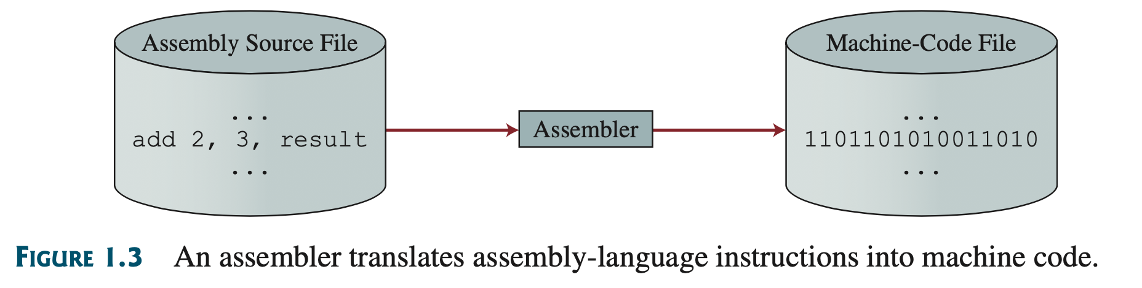
1.3 ___________ translates high-level language program into machine language program.
A. An assembler B. A compiler C. CPU D. The operating system

Slide 14
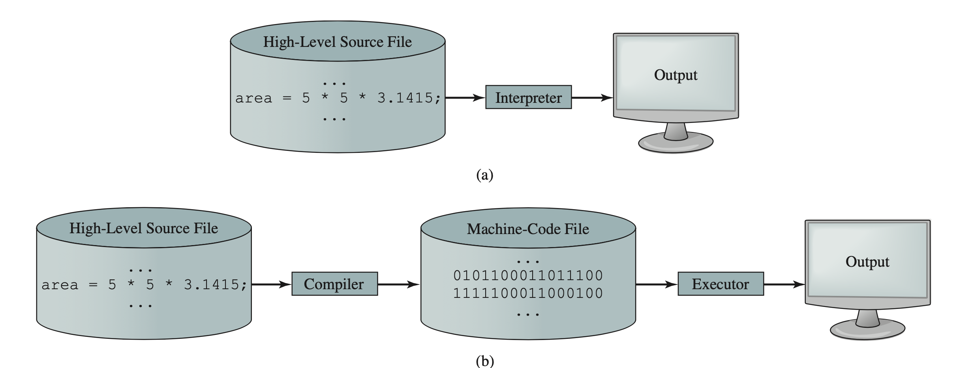
1.3 ___________ translates high-level language program into machine language program.
A. An assembler B. A compiler C. CPU D. The operating system

Slide 15
1.3 ___________ translates high-level language program into machine language program.
A. An assembler B. A compiler C. CPU D. The operating system

Slide 16
1.7 What is the output of the following code?
System.out.println("1 + 2 + 3");
System.out.println(1 + 2 + 3);
A. 1 + 2 + 3 followed by 6 B. "6" followed by 6 C. 1 + 2 + 3 followed by 1 + 2 + 3
D. 6 followed by 6

Slide 17
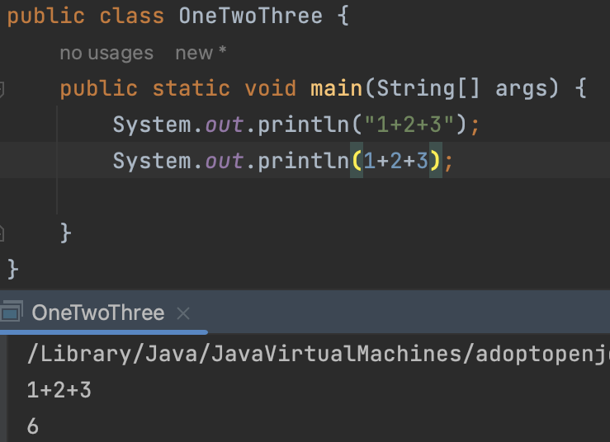
1.7 What is the output of the following code?
System.out.println("1 + 2 + 3");
System.out.println(1 + 2 + 3);
A. 1 + 2 + 3 followed by 6 B. "6" followed by 6 C. 1 + 2 + 3 followed by 1 + 2 + 3
D. 6 followed by 6
String ->
Number ->

Slide 18
1.7 What is the output of the following code?
System.out.println("1 + 2 + 3");
System.out.println(1 + 2 + 3);
A. 1 + 2 + 3 followed by 6 B. "6" followed by 6 C. 1 + 2 + 3 followed by 1 + 2 + 3
D. 6 followed by 6

Slide 19
1.8 The JDK command to just compile a class (not run) in the file Test.java is
java Test
java Test.java
C. javac Test.java
D. javac Test E. JAVAC Test.java
1.9 Which JDK command is correct to run a Java application in ByteCode.class?
java ByteCode
B. java ByteCode.class
C. javac ByteCode.java
D. javac ByteCode E. JAVAC ByteCode

Slide 20
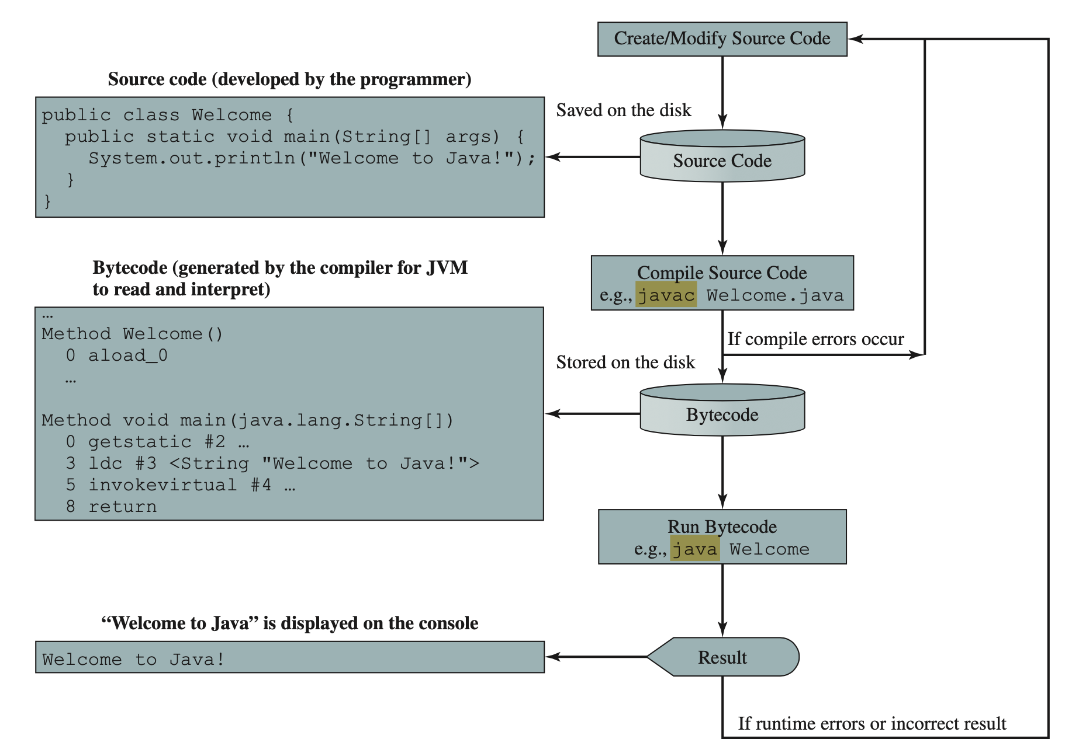
1.8 The JDK command to just compile a class (not run) in the file Test.java is
java Test
java Test.java
C. javac Test.java
D. javac Test E. JAVAC Test.java
1.9 Which JDK command is correct to run a Java application in ByteCode.class?
java ByteCode
B. java ByteCode.class
C. javac ByteCode.java
D. javac ByteCode E. JAVAC ByteCode

Slide 21
1.8 The JDK command to just compile a class (not run) in the file Test.java is
java Test
java Test.java
C. javac Test.java
D. javac Test E. JAVAC Test.java
1.9 Which JDK command is correct to run a Java application in ByteCode.class?
java ByteCode
B. java ByteCode.class
C. javac ByteCode.java
D. javac ByteCode E. JAVAC ByteCode

Slide 22
1.8 The JDK command to just compile a class (not run) in the file Test.java is
java Test
java Test.java
C. javac Test.java
D. javac Test E. JAVAC Test.java
1.9 Which JDK command is correct to run a Java application in ByteCode.class?
java ByteCode
B. java ByteCode.class
C. javac ByteCode.java
D. javac ByteCode E. JAVAC ByteCode

Slide 23
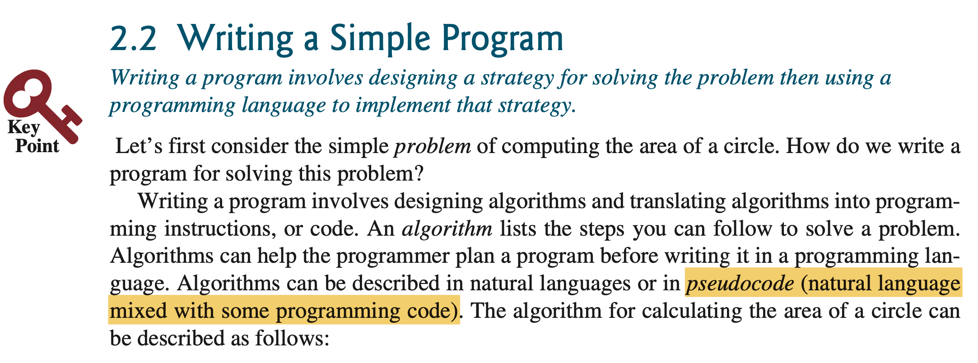
2.1 _______ is the code with natural language
mixed with Java code.
A. Java program B. A Java statement C. Pseudocode D. A flowchart diagram

Slide 24
2.1 _______ is the code with natural language
mixed with Java code.
A. Java program B. A Java statement C. Pseudocode D. A flowchart diagram

Slide 25
2.6 Every letter in a Java keyword is in lowercase?
true B. false
2.7 Which of the following is a valid identifier?
Please select all that apply.
$343
B. class C. 9X
D. 8+9
E. radius

Slide 26
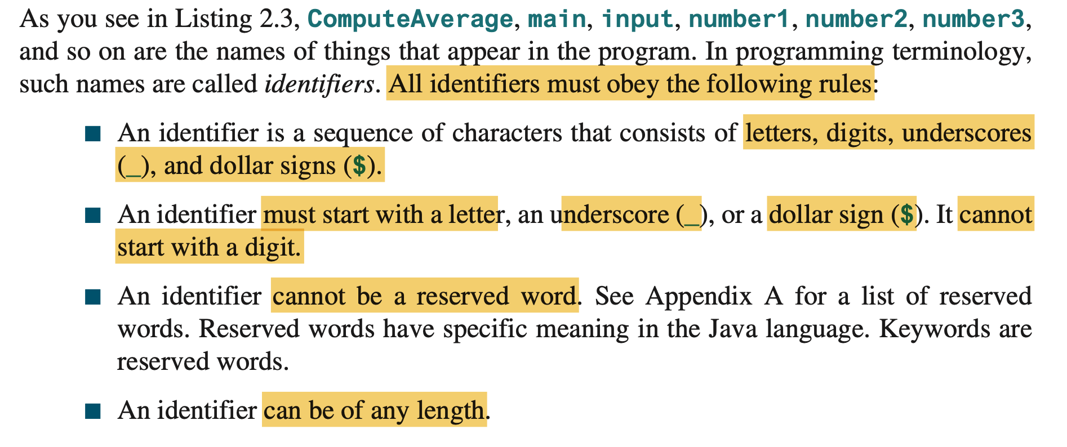

Slide 27
2.6 Every letter in a Java keyword is in lowercase?
true B. false
2.7 Which of the following is a valid identifier?
Please select all that apply.
$343
B. class C. 9X
D. 8+9
E. radius

Slide 28
2.17 Which of these data types requires the most amount of memory?
A. long B. int C. short D. byte

Slide 29
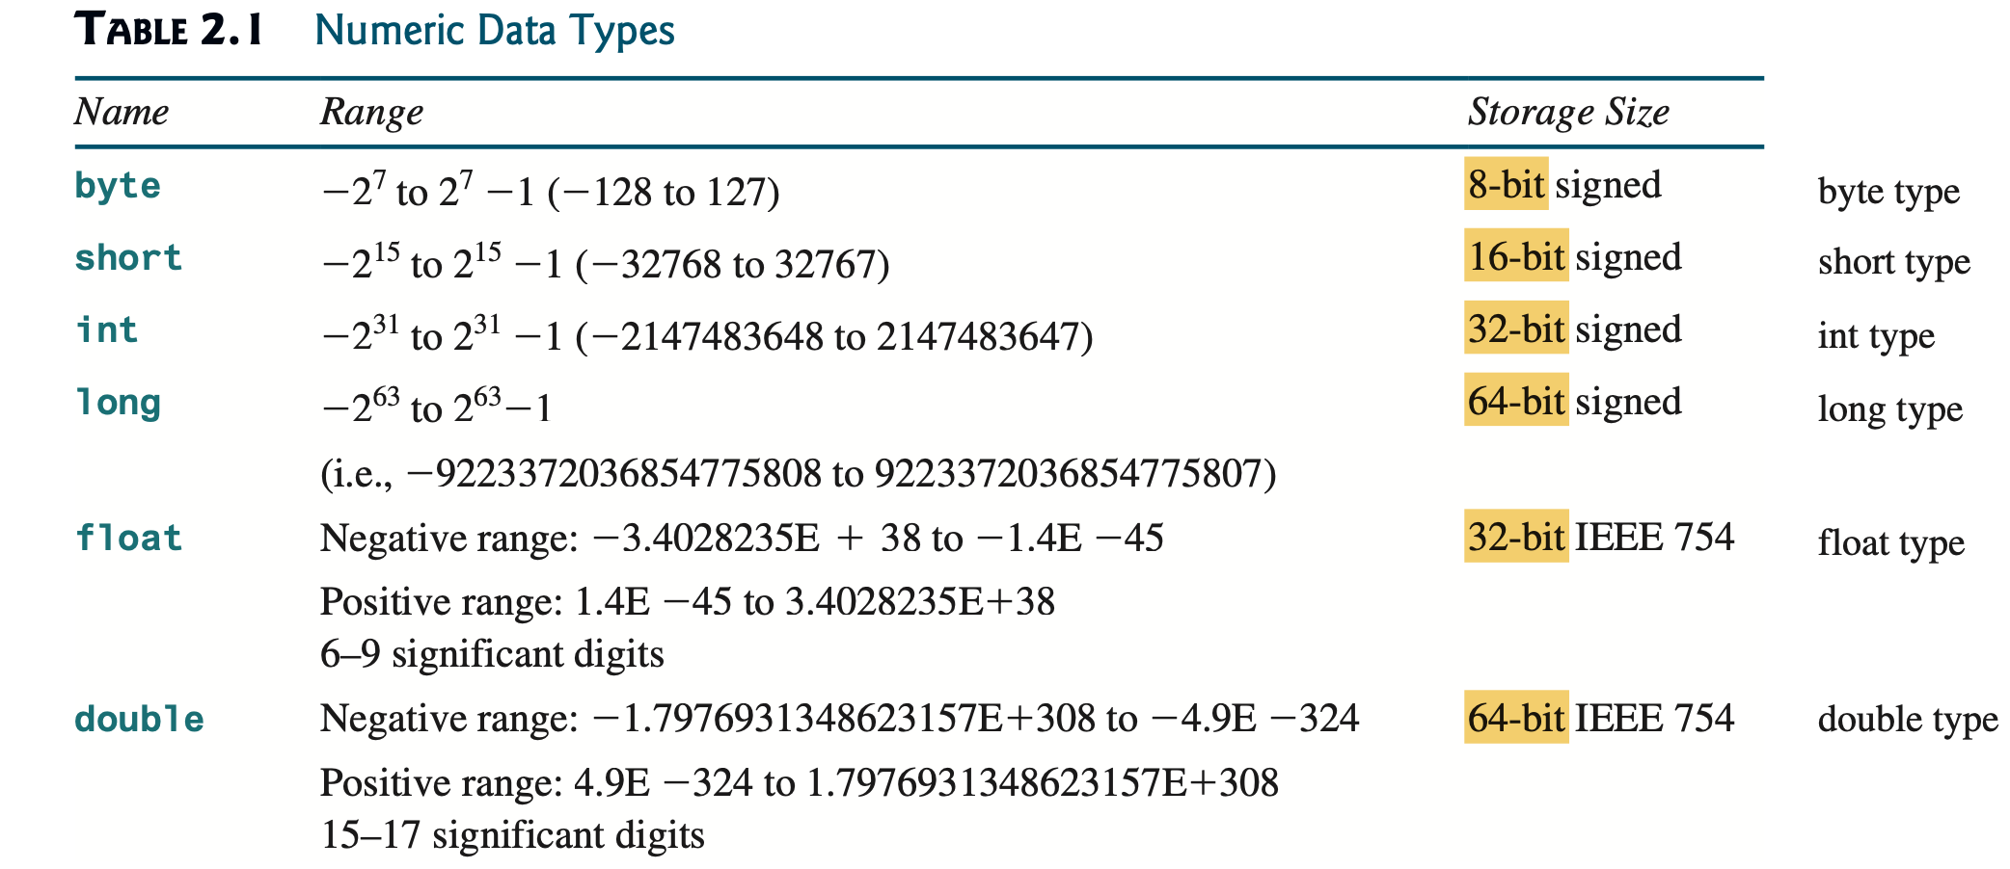
2.17 Which of these data types requires the most amount of memory?
A. long B. int C. short D. byte

Slide 30
2.37 To obtain the current second, use _________.
A. System.currentTimeMillis() % 3600 B. System.currentTimeMillis() % 60 C. System.currentTimeMillis() / 1000 % 60
D. System.currentTimeMillis() / 1000 / 60 % 60
E. System.currentTimeMillis() / 1000 / 60 / 60 % 24

Slide 31
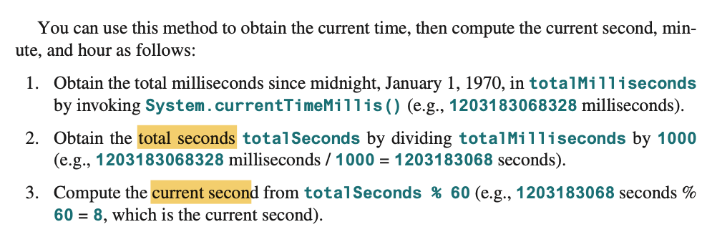
2.37 To obtain the current second, use _________.
A. System.currentTimeMillis() % 3600 B. System.currentTimeMillis() % 60 C. System.currentTimeMillis() / 1000 % 60
D. System.currentTimeMillis() / 1000 / 60 % 60
E. System.currentTimeMillis() / 1000 / 60 / 60 % 24

Slide 32
2.37 To obtain the current second, use _________.
A. System.currentTimeMillis() % 3600 B. System.currentTimeMillis() % 60 C. System.currentTimeMillis() / 1000 % 60
D. System.currentTimeMillis() / 1000 / 60 % 60
E. System.currentTimeMillis() / 1000 / 60 / 60 % 24

Slide 33
3.4 What is 1 - 0.1 - 0.1 - 0.1 - 0.1 - 0.1 == 0.5?
true
B. false C. There is no guarantee that
1 - 0.1 - 0.1 - 0.1 - 0.1 - 0.1 == 0.5 is true.

Slide 34
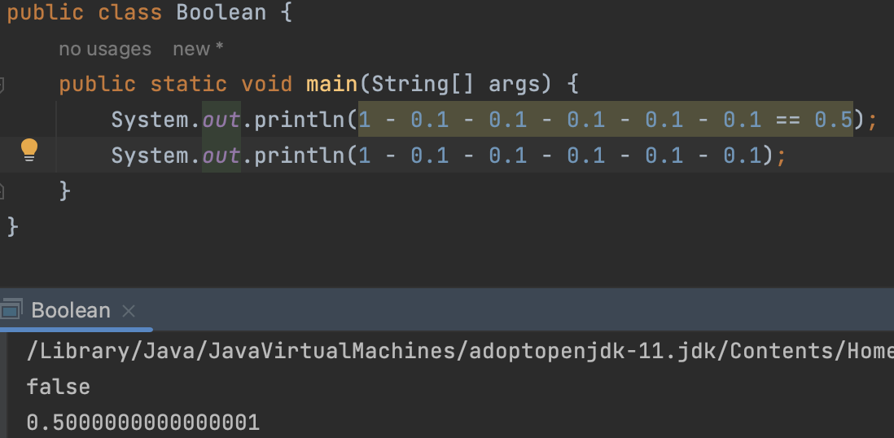
3.4 What is 1 - 0.1 - 0.1 - 0.1 - 0.1 - 0.1 == 0.5?
true
B. false C. There is no guarantee that
1 - 0.1 - 0.1 - 0.1 - 0.1 - 0.1 == 0.5 is true.

Slide 35
3.4 What is 1 - 0.1 - 0.1 - 0.1 - 0.1 - 0.1 == 0.5?
true
B. false C. There is no guarantee that
1 - 0.1 - 0.1 - 0.1 - 0.1 - 0.1 == 0.5 is true.

Slide 36
3.26 Given |x| <= 4, which of the following
is true?
x <= 4 && x >= 4
B. x <= 4 && x > -4
C. x <= 4 && x >= -4
D. x <= 4 || x >= -4

Slide 37
3.26 Given |x| <= 4, which of the following
is true?
x <= 4 && x >= 4
B. x <= 4 && x > -4
C. x <= 4 && x >= -4
D. x <= 4 || x >= -4
-4 <= x <= 4

Slide 38
3.26 Given |x| <= 4, which of the following
is true?
x <= 4 && x >= 4
B. x <= 4 && x > -4
C. x <= 4 && x >= -4
D. x <= 4 || x >= -4
-4 <= x <= 4

Slide 39
3.39 What is the output of the following code?
boolean even = false;
System.out.println(even ? "true" : "false");
A. true C. nothing
B. false D. true false

Slide 40
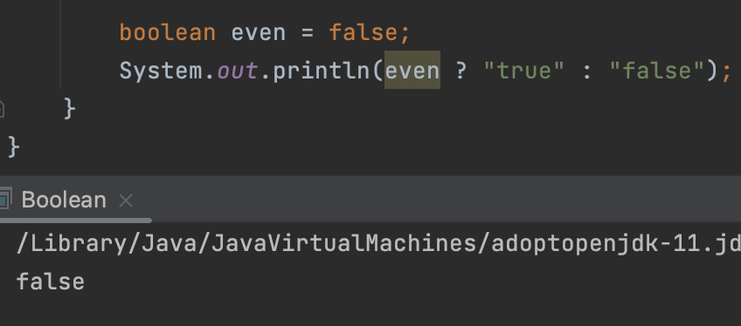
3.39 What is the output of the following code?
boolean even = false;
System.out.println(even ? "true" : "false");
A. true C. nothing
B. false D. true false

Slide 41
3.39 What is the output of the following code?
boolean even = false;
System.out.println(even ? "true" : "false");
A. true C. nothing
B. false D. true false

Slide 42
4.1 To obtain the sine of 35 degrees, use _______.
Math.sin(35)
B. Math.sin(Math.toRadians(35))
C. Math.sin(Math.toDegrees(35))
D. Math.sin(Math.toRadian(35))
E. Math.sin(Math.toDegree(35))

Slide 43
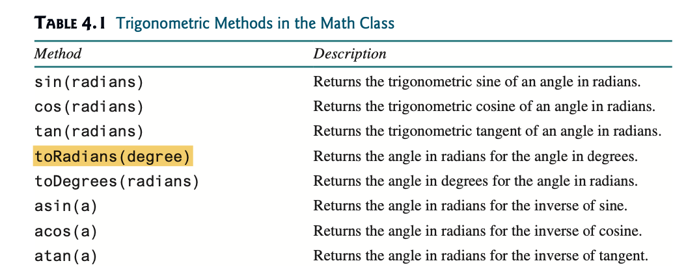
4.1 To obtain the sine of 35 degrees, use _______.
Math.sin(35)
B. Math.sin(Math.toRadians(35))
C. Math.sin(Math.toDegrees(35))
D. Math.sin(Math.toRadian(35))
E. Math.sin(Math.toDegree(35))

Slide 44
4.1 To obtain the sine of 35 degrees, use _______.
Math.sin(35)
B. Math.sin(Math.toRadians(35))
C. Math.sin(Math.toDegrees(35))
D. Math.sin(Math.toRadian(35))
E. Math.sin(Math.toDegree(35))

Slide 45
4.18 Suppose x is a char variable with a value 'b’.
What is the output of the statement
System.out.println(++x)?
a B. b C. c D. d

Slide 46
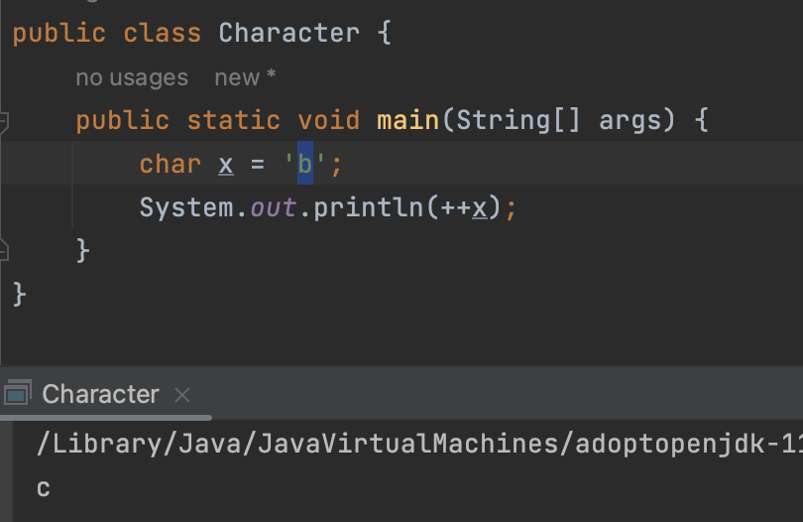
4.18 Suppose x is a char variable with a value 'b’.
What is the output of the statement
System.out.println(++x)?
a B. b C. c D. d

Slide 47
4.18 Suppose x is a char variable with a value 'b’.
What is the output of the statement
System.out.println(++x)?
a B. b C. c D. d

Slide 48
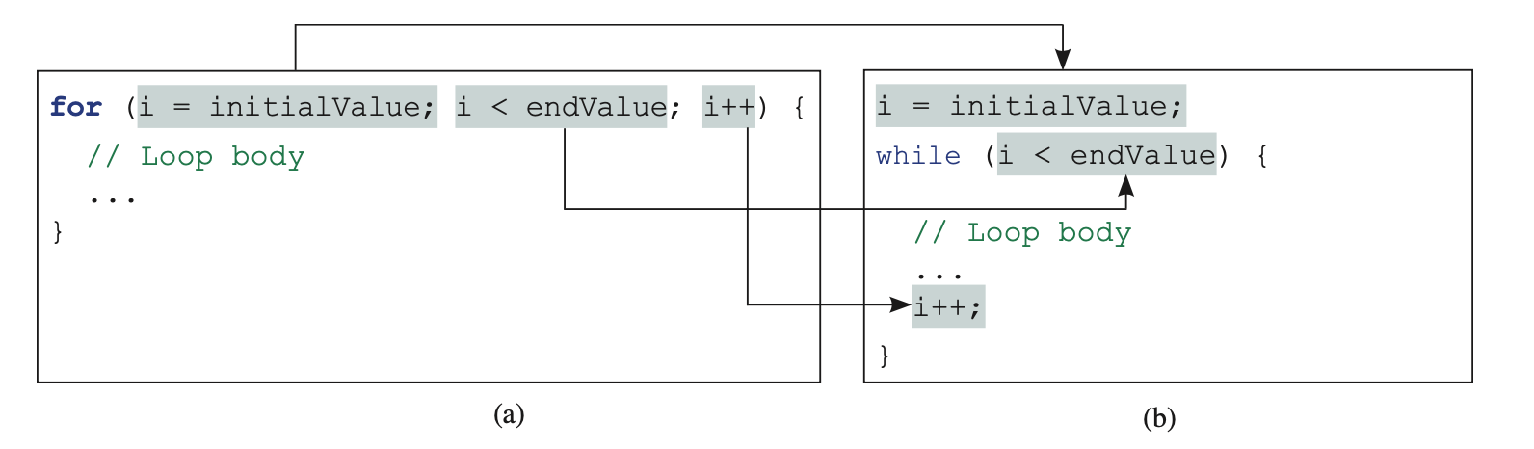
Difference between for and while

Slide 49
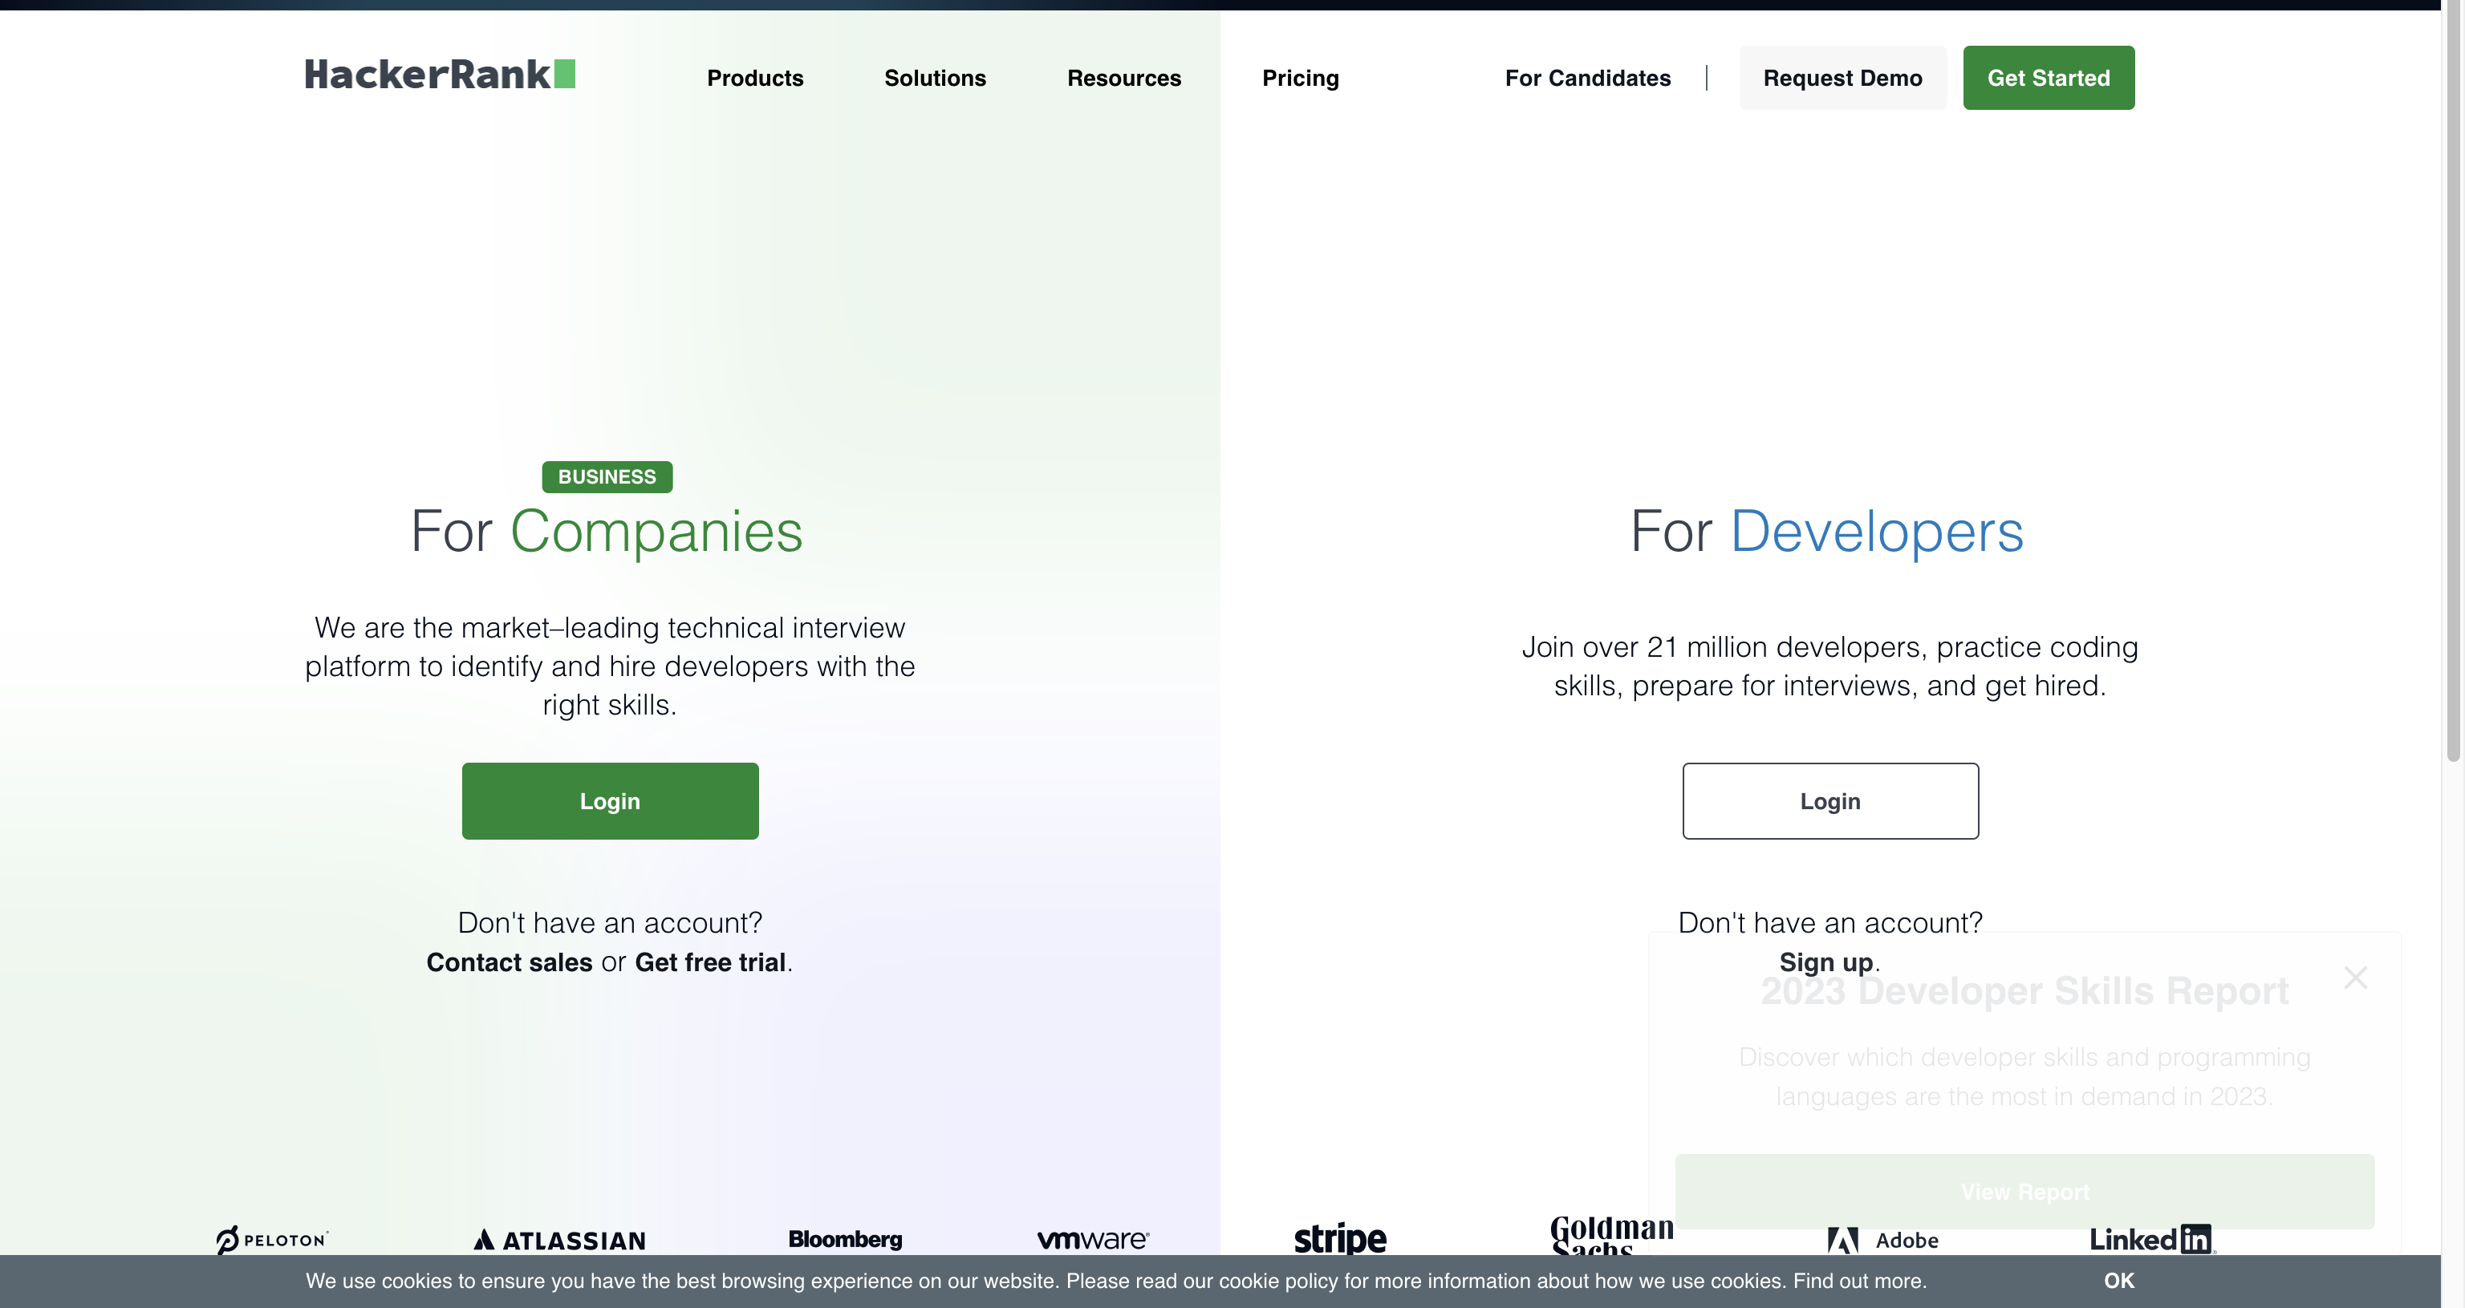
https://www.hackerrank.com/

Slide 50
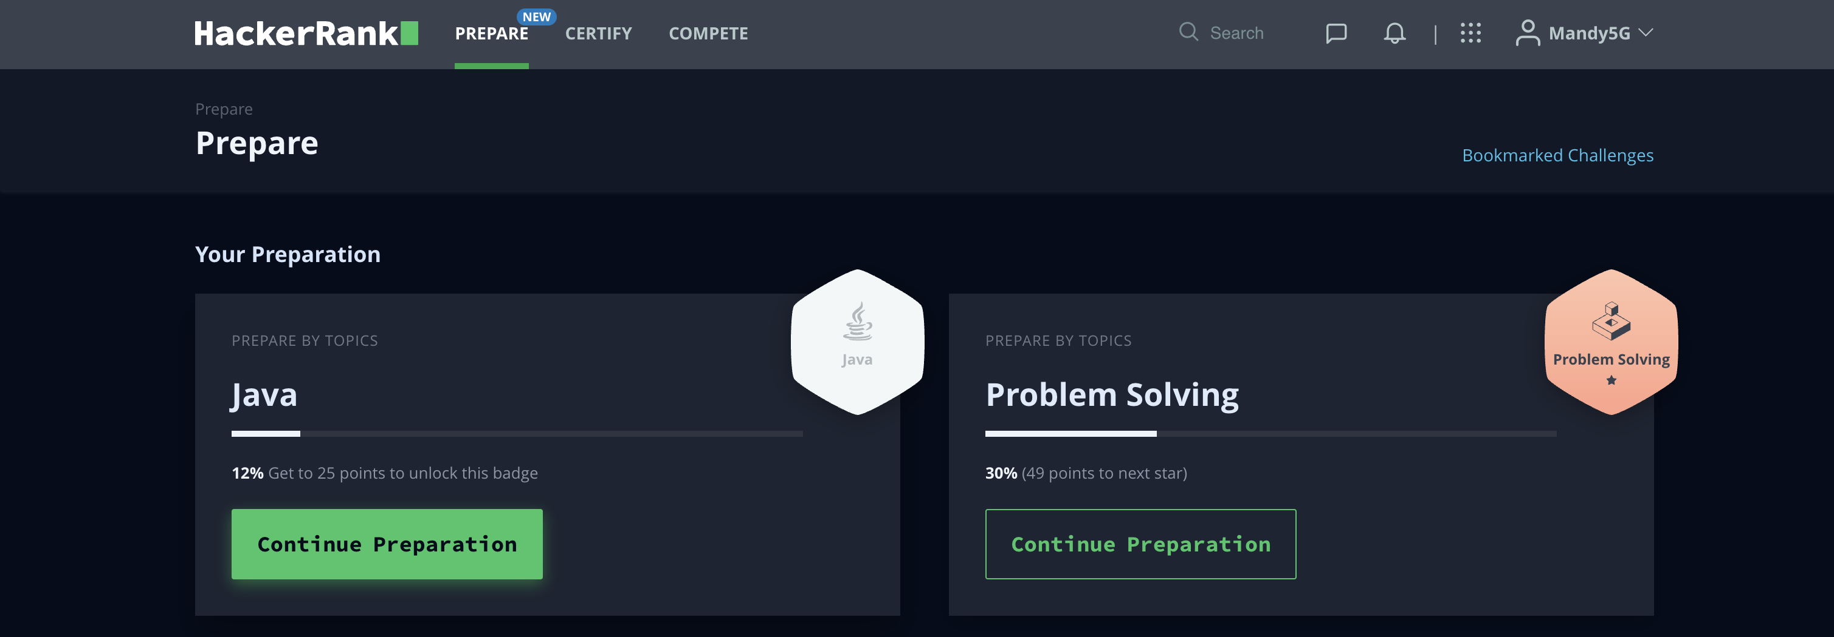
https://www.hackerrank.com/

Slide 51
Introduction to Java
The term Java from Java island….
JIU IT Major 20230124 PMJ, AEJ

